Slide 1
osmoregulation
Year 11 Biology
Bremer SHS

Slide 2
Water balance- chapter 13 in text book
In animals
identify and explain the various homeostatic mechanisms that maintain water balance in animals (Osmoregulators and osmoconformers) in terms of
- structural features (excretory system)
- behavioural responses
- physiological mechanisms
- homeostatic mechanisms (antidiuretic hormone (ADH) and the kidney)
In plants
identify and explain the various mechanisms that maintain water balance in plants in terms of
- structural features (stomata, vacuoles, cuticle)
- homeostatic mechanisms (abscisic acid)
- consider xerophytes, hydrophytes, halophytes and mesophytes in responses

Slide 3
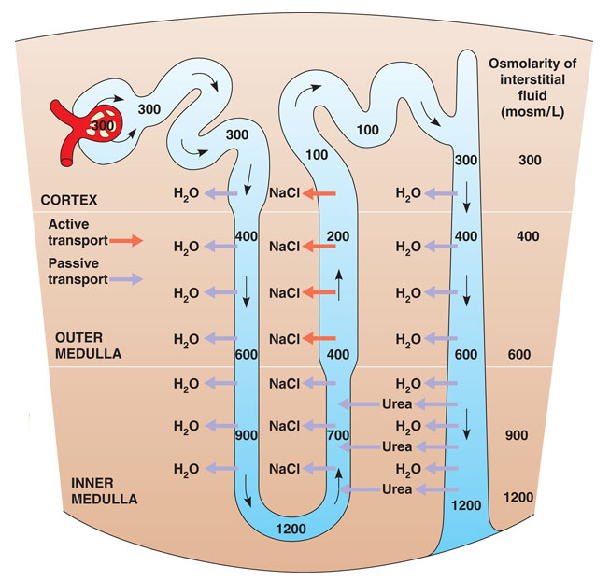
Water balance in animals
Organisms are continually gaining and losing water but the overall composition and volume of an organisms extracellular environment must be kept within ranges that it can tolerate.
Osmoregulation is the process by which internal water and solute concentration is maintained.
In vertebrates, an excretory system is important for balancing the intakes and output of water and solute.
In a mammalian kidney, water is conserved when it is removed in the descending Loop of Henle. The longer the loop of Henle, the more water is saved.

Slide 4
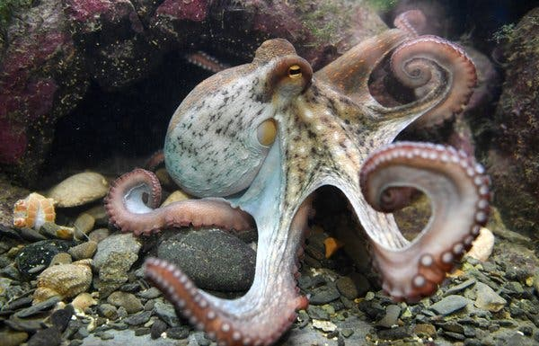
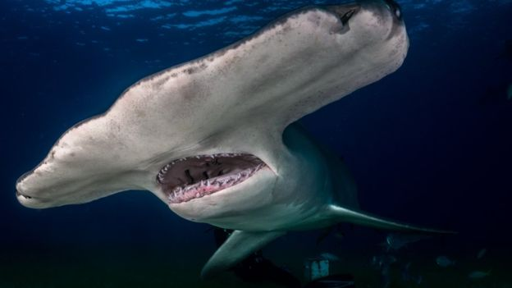
Osmoregulators and osmoconformers
Osmoregulators are organisms regulate their osmotic concentration to be either higher or lower than their external environment.
Osmoconformers allow their osmotic concentration to be equal to the concentration of the external environment.
Most marine invertebrates are osmoconformers, as their interstitial fluid fluctuates to match the external environment.

Slide 5
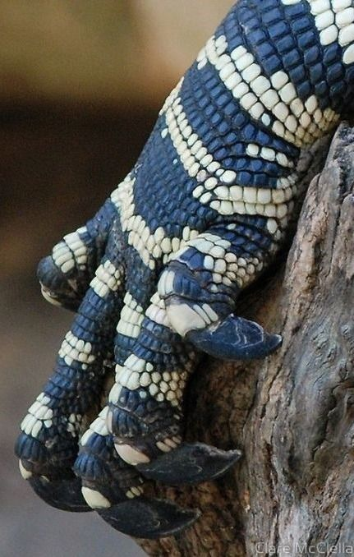
Osmoregulation- structural adaptations
Dehydration is a major problem for land animals, so adaptations that reduce water loss are important for survival.
A waterproof or impermeable outer layer can reduce water loss, like scales, hair and feathers.
The kidneys help maintain a constant internal environment by helping regulate osmoregulation by removing nitrogenous wastes and regulating water concentration in blood.
The goanna has scales made of keratin that help prevent water loss.

Slide 6
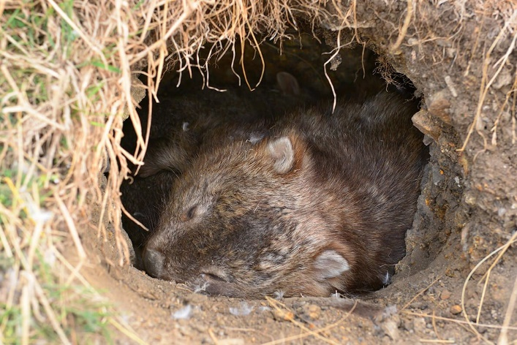
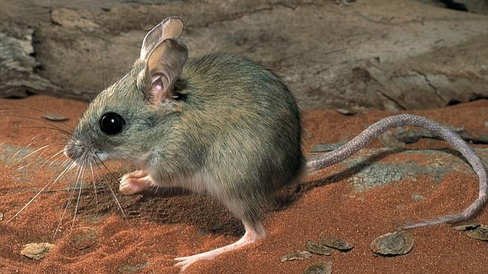
Osmoregulation- Behavioural adaptations
Many animals exhibit behavioural responses to assist them in controlling their internal ion concentration.
Dessert animals spend a large amount of time in burrows, as burrows have a lower temperature and higher humidity than the open air, so water loss is reduced.
The spinifex hopping mouse wraps its tail around its face. This reduces water loss by saturating the air between the hairs at its body surface and the air in the burrow with water vapour.
A wombat seeks shelter in a burrow during hot periods of the day.
Spinifex hopping mouse from Queensland, Australia.

Slide 7
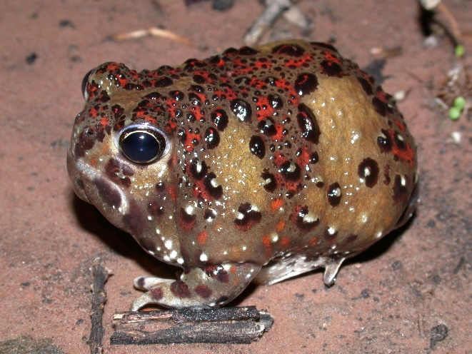
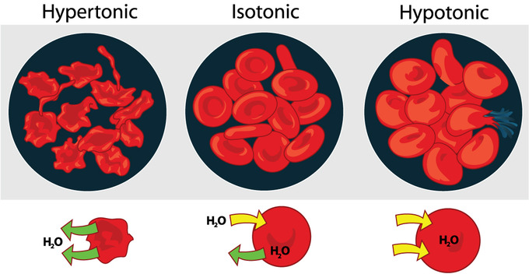
Osmoregulation- physiological adaptations
The Australian dessert frog slows the production of urine by reducing the rate of glomerular filtration. The frog swells up like a ball retaining urine in its bladder for use in the dry season.
Water is lost through the gill surfaces of marine vertebrates, so they drink copious amounts of sea water which increases salt intake. They solve this problem by actively removing salts by special chloride excretory cells in the gills, and having a slow filtration rate and excreting concentrated nitrogenous wastes. All this helps to reduce water loss.
The extracellular fluids of marine vertebrates tend to be hypotonic, as the body fluids are of a lower concentration than the liquid they live in.

Slide 8
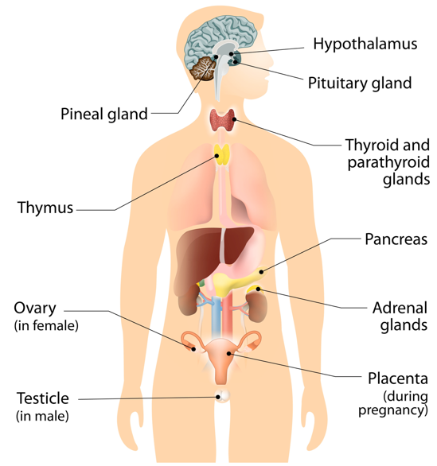
Osmoregulation - Homeostatic adaptations
In the process of dehydration, the hypothalamus registers the critically low water level, the hypothalamus sends a signal to pituitary glands where the antidiuretic hormone is secreted for further use. This hormone signals the kidney to reabsorb water from the body.
The kidneys do not stop reabsorbing water until the pituitary glands send a signal to reduce the production of the hormone.
In the process of waterlogging, the production and secretion of antidiuretic hormones is stopped, making the kidney cease the reabsorption of water from the blood.

Slide 9
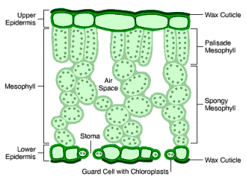
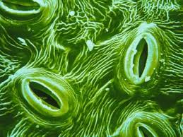
Water transport in plants
Plants are Osmoregulators.
Although water is essential for survival of the plant, it is continually being lost to the environment through the stomatal pores of the leaf surface.
Plants have a range of features that help the plant obtain and/or retain their balance.

Slide 10
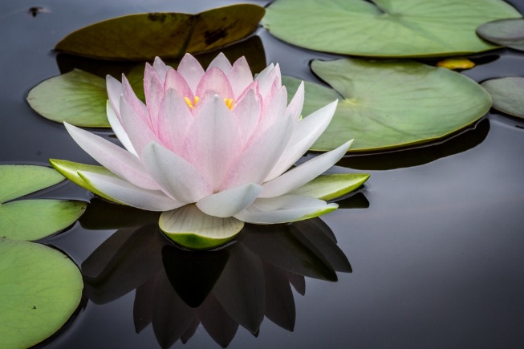
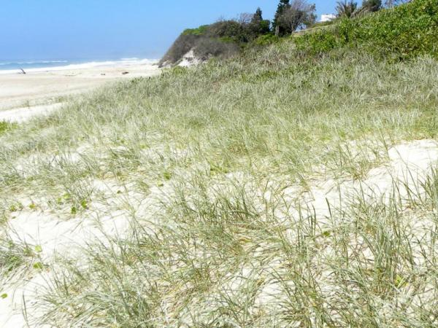
mesophytes, hydrophytes and halophytes
Mesophyte live in areas with adequate water, so they have not needed any extreme adaptations.
Hydrophytes live in aquatic environments. These don’t need any adaptations for water retention but the water contains less oxygen than air. So their leaves have an abundance of air-filled intercellular spaces through which air can move.
Halophytes live in salty conditions. They have to take up water from the external environment that has a higher salt concentration than ordinary soil water. They actively absorb salt into their roots and this results in the solute concentration of the tissues is higher than that of the surrounding water, initiating osmosis.
Some hydrophytes like water lilies only have stomata on the upper surfaces of the leaves.
Spinifex grass can tolerate very salty conditions.

Slide 11
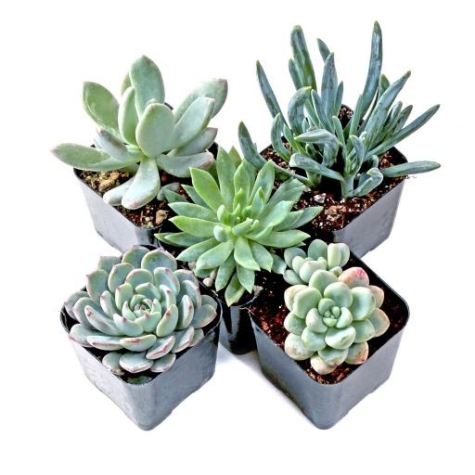
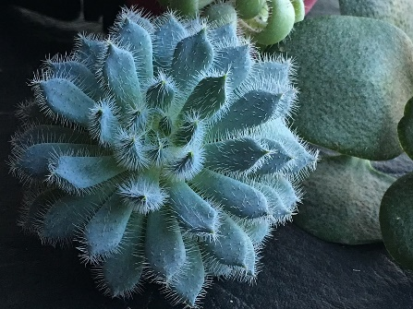
Osmoregulation -Structural adaptations
A thick waxy cuticle on the leaf surface- epidermal cells on the surface of the leaf secrete a translucent, water-impermeable cuticle layer, which coats cell wall areas exposed to the air.
Reduced numbers of stomata on the top of the leaf and increased numbers on the bottom of the leaf
Sunken stomata- found on the underside of the leaves or in grooves
Cylindrical or rolled leaves
Reduced leaf numbers or no leaves
Hairs on leaves
Controlled water loss at stomata- the number and size of stomata are reduced in xerophytes
Succulents store water in the vacuoles taking up to 90% of the cell space.

Slide 12
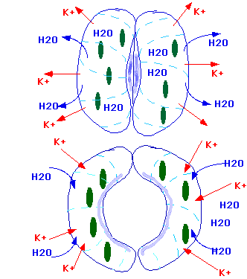
Osmoregulation - homeostatic adaptations
Abscisic acid (ABA) is a key hormone that regulates water and stomatal movement in plants.
Stomata in leaves respond to environmental conditions by opening and closing in response to water loss. The guard cells surrounding the stomatal pore lose water, turgor pressure drops and the 2 guard cells collapse against each other and the stoma closes.
When a plant is deficient in water, the cells in the roots and leaves respond by producing ABA, which then accumulates in the guard cells. This causes a rapid change in the osmotic pressure in the guard cells causing them to lose turgidity and the stoma close.

